Slide 1
Assignment 6 SPATIAL FILTERING USING MATLAB
Mudit Dholakia
MT-006
Guide:-Prof. Tushar. V. Ratanpara

Slide 2
AIM 1
Implement spatial filtering program as follows.
Load the image data
Use a spatial filter to get the horizontal edge of the image.
Use a spatial filter to get the vertical edge of the image (read the MATLAB documentation on fspecial).
Add the horizontal edge matrix to the vertical edge matrix.

Slide 3
Code:-
clc;
clear all;
close all;
I=imread('lena.jpg');
h=fspecial('sobel');
v=(fspecial('sobel'))';
hor=imfilter(I,h);
ver=imfilter(I,v);
final=hor+ver;
imshow(final);

Slide 4
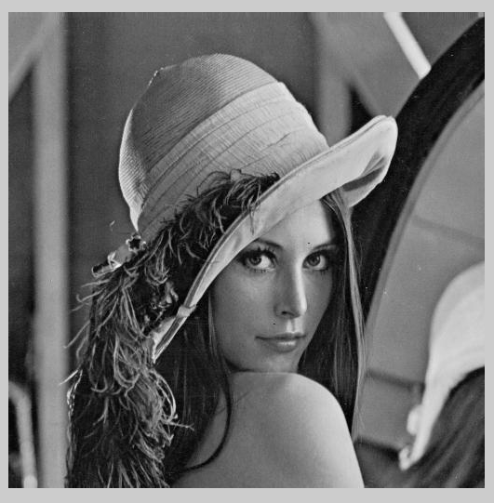
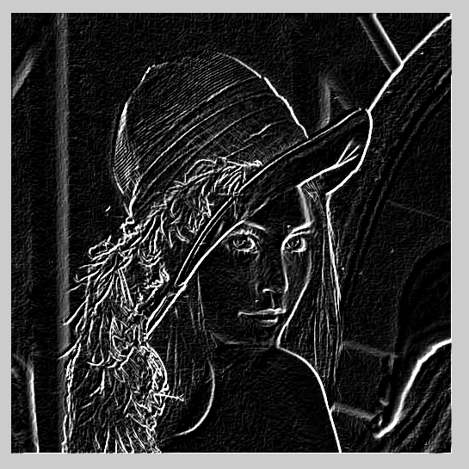
Original Image
Resultant Image

Slide 5
AIM 2
What Is Image Filtering in the Spatial Domain?

Slide 6
Spatial Filtering
Define a center point (x;,y)
Perform an operation that involves only the pixels in a predefined neighbourhood
Result of the operation response of the process at that point
Repeat the process for every pixel in the image

Slide 8
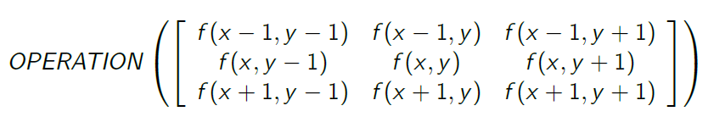
Spatial Filtering
Output is a function of a pixel value and its neighbours
Possible operations are: sum, weighted sum, average, weightedaverage, min, max, median etc.
Example: 3*3 neighbourhood

Slide 9
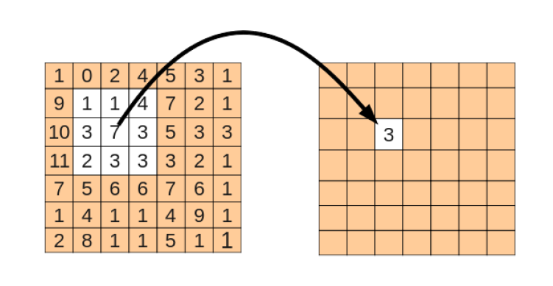
Spatial Filtering

Slide 10
Spatial Filtering
Linear Filters:
Smoothing Filters
Mean Filter
Gaussian Filter
Edge enhancing Filters
Sobel Filter
Prewitt Filter
Laplace Filter
Non-linear Filters:
Min, Max
Median, Percentile Filters

Slide 11
AIM 3
Implement matlab programs of smoothing linear filters.(without using fspecial and imfilter function)
Average filter
Weighted average filter

Slide 12
Average Filter

Slide 13
Code:-
clc;
clear all;
close all;
a=imread(‘b.tif');
figure, imshow(a)
an=imnoise(a,'gaussian');
[m,n]=size(an);
figure, imshow(uint8(an))
b=input('Enter Averaging Mask size: ');
z=ones(b);
[p,q]=size(z);
w=1:p;
x=round(median(w));
anz=zeros(m+2*(x-1),n+2*(x-1));

Slide 14
Code:-(Cont’d)
for i=x:(m+(x-1))
for j=x:(n+(x-1))
anz(i,j)=an(i-(x-1),j-(x-1));
end
end
figure, imshow(uint8(anz))
sum=0;
x=0;
y=0;

Slide 15
Code:-(Cont’d)
for i=1:m
for j=1:n
for k=1:p
for l=1:q
sum= sum+anz(i+x,j+y)*z(k,l);
y=y+1;
end
y=0;
x=x+1;
end
x=0;
ans(i,j)=(1/(p*q))*(sum);
sum=0;
end
end
figure, imshow(uint8(ans))

Slide 16
Average Filter

Slide 17
Weighted Average Filter

Slide 18
Code:-
clc
clear all
close all
a=imread('cameraman.tif');
figure, imshow(a)
an=imnoise(a,'gaussian');
[m,n]=size(an);
figure, imshow(uint8(an))
b=input('Enter Averaging Mask size: ');
%z=ones(b);

Slide 19
Code:-(Cont’d)
for i=1:b
for j=1:b
z(i,j)=input('Mask Values:-')
end
end
smsk=0;
for i=1:b
for j=1:b
smsk=smsk+sum(z(i,j));
end
end
[p,q]=size(z);

Slide 20
Code:-(Cont’d)
w=1:p;
x=round(median(w));
anz=zeros(m+2*(x-1),n+2*(x-1));
for i=x:(m+(x-1))
for j=x:(n+(x-1))
anz(i,j)=an(i-(x-1),j-(x-1));
end
end
figure, imshow(uint8(anz))

Slide 21
Code:-(Cont’d)
sum=0;
x=0;
y=0;
for i=1:m
for j=1:n
for k=1:p
for l=1:q
sum= sum+anz(i+x,j+y)*z(k,l);
y=y+1;
end
y=0;
x=x+1;
end
x=0;
ans(i,j)=(1/(p*q))*(sum);
sum=0;
end
end
for i=1:b
for j=1:b
ans(i,j)=ans(i,j)/smsk;
end
end
figure, imshow(uint8(ans))

Slide 22
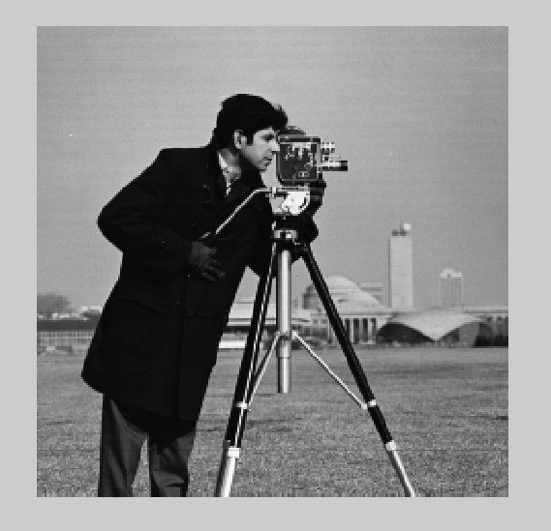
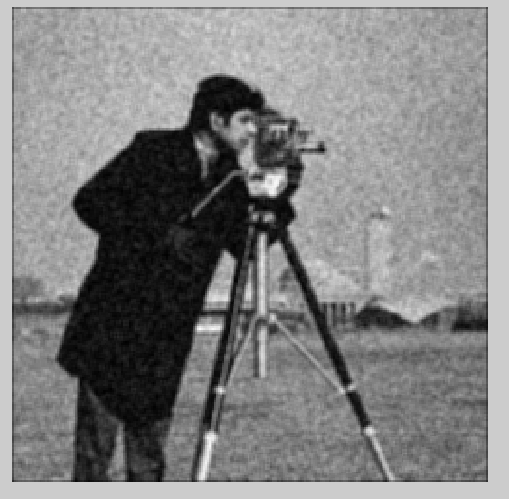
Weighted Average Filter

Slide 23
AIM 4
Implement matlab programs of order-statistic (Nonlinear) filters. (without using fspecial and imfilter)
Median filter
Max filter
Min filter

Slide 24
Mean Filter

Slide 25
Code:-
clear all
close all
clc
I = imread('cameraman.tif');
I = imnoise(I, 'salt & pepper', 0.01);
[r c] = size(I);
Rep = zeros(r + 2, c + 2);
for x = 2 : r + 1
for y = 2 : c + 1
Rep(x,y) = I(x - 1, y - 1);
end
end

Slide 26
Code:-(Cont’d)
B = zeros(r, c);
for x = 1 : r
for y = 1 : c
for i = 1 : 3
for j = 1 : 3
q = x - 1; w = y -1;
array((i - 1) * 3 + j) = Rep(i + q, j + w);
end
end
B(x, y) = median(array(:));
end
end
figure, imshow(I);
figure, imshow(uint8(B));

Slide 27
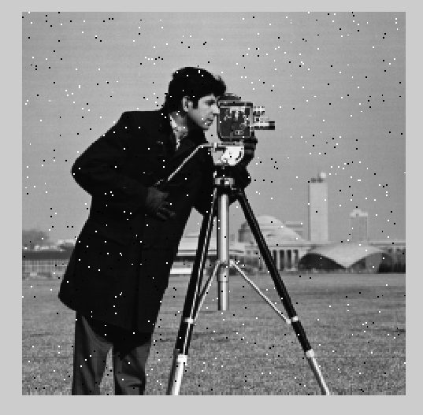
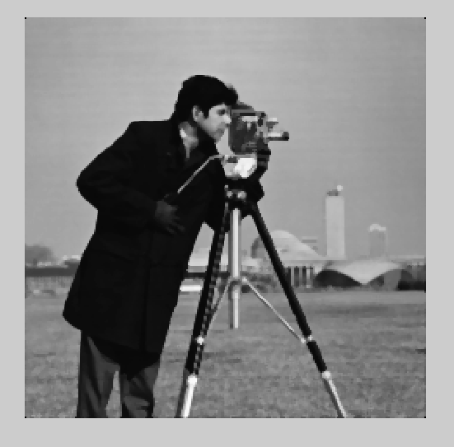
Mean Filter

Slide 28
Max Filter

Slide 29
Code:-
clc
clear all
close all
a=imread('cameraman.tif');
figure, imshow(a)
an=imnoise(a,'gaussian');
[m,n]=size(an);
figure, imshow(uint8(an))
b=input('Enter Averaging Mask size: ');
z=ones(b);
[p,q]=size(z);

Slide 30
Code:-(Cont’d)
w=1:p;
x=round(median(w));
anz=zeros(m+2*(x-1),n+2*(x-1));
for i=x:(m+(x-1))
for j=x:(n+(x-1))
anz(i,j)=an(i-(x-1),j-(x-1));
end
end
figure, imshow(uint8(anz))

Slide 31
Code:-(Cont’d)
sum=0;
x=0;
y=0;
minn=0;
for i=1:m
for j=1:n
for k=1:p
for l=1:q
sum=anz(i+x,j+y)*z(k,l);
if sum >= minn
minn=sum;
end
y=y+1;
end
y=0;
x=x+1;
end
x=0;
ans(i,j)=minn;
sum=0;
minn=0;
end
end
figure, imshow(uint8(ans))

Slide 32
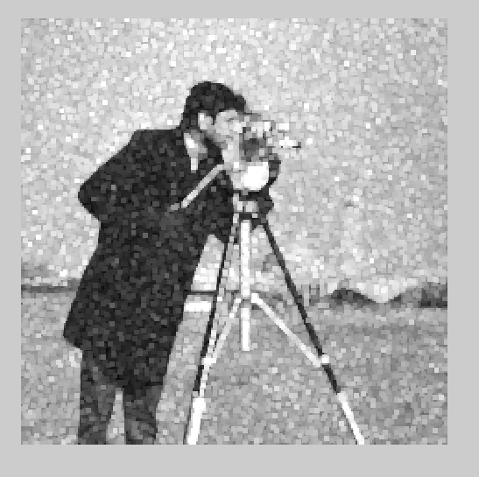
Max Filter

Slide 33
Min Filter

Slide 34
Code:-
clc
clear all
close all
a=imread('cameraman.tif');
figure, imshow(a)
an=imnoise(a,'gaussian');
[m,n]=size(an);
figure, imshow(uint8(an))
b=input('Enter Averaging Mask size: ');
z=ones(b);
[p,q]=size(z);

Slide 35
Code:-(Cont’d)
w=1:p;
x=round(median(w));
anz=ones(m+2*(x-1),n+2*(x-1));
for i=x:(m+(x-1))
for j=x:(n+(x-1))
anz(i,j)=an(i-(x-1),j-(x-1));
end
end
figure, imshow(uint8(anz))

Slide 36
Code:-(Cont’d)
sum=0;
x=0;
y=0;
minn=0;
for i=1:m
for j=1:n
for k=1:p
for l=1:q
sum=anz(i+x,j+y)*z(k,l);
if sum < minn
minn=sum;
end
y=y+1;
end
y=0;
x=x+1;
end
x=0;
ans(i,j)=minn;
sum=0;
minn=0;
end
end
figure, imshow(uint8(ans))

Slide 37
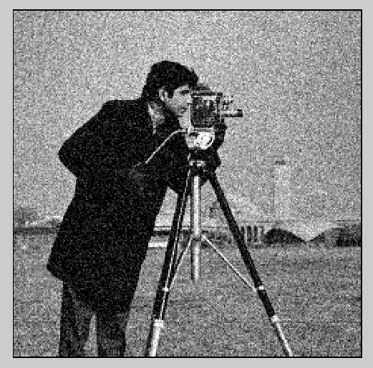
Min Filter

Slide 38
AIM 5
Implement matlab programs of Sharpening filters using following operators.
Laplacian operator
Sobel operator
Prewitt operator

Slide 39
Code:-
clc;
clear all;
close all;
I=imread('lena.jpg');
s=fspecial('sobel');
l=fspecial('laplacian');
p=fspecial('prewitt');
sb=imfilter(I,s);
lp=imfilter(I,l);
pw=imfilter(I,p);

Slide 40
Code:-(Cont’d)
figure,imshow(sb);title('Sobel operator in fspecial()')
figure,imshow(lp);title('Laplacian operator in fspecial()')
figure,imshow(pw);title('Prewitt operator in fspecial()')

Slide 41
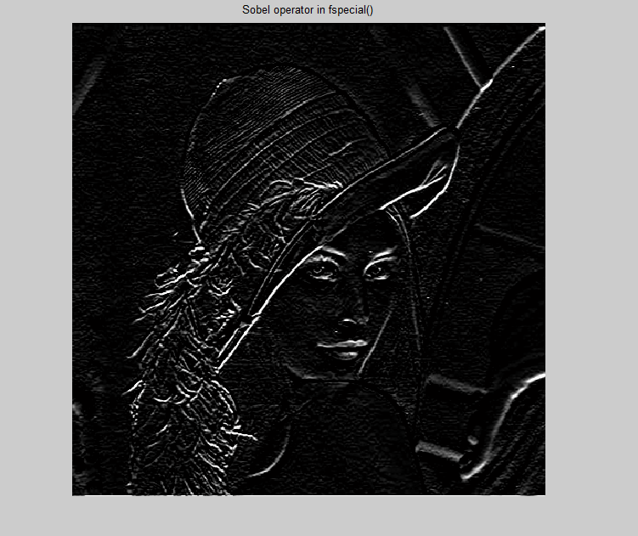
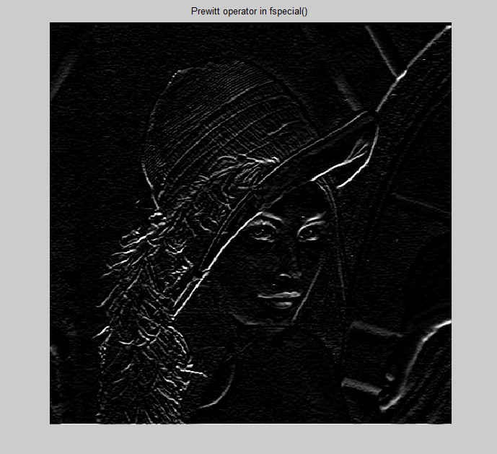
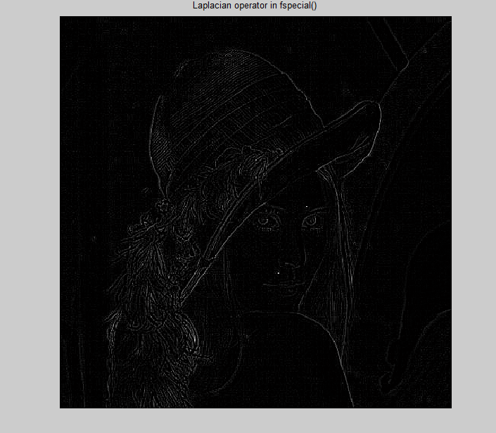
Laplacian
Sobel
Prewitt

Slide 42
THANK YOU

